Slide 1
MAR 580: Models for Marine Ecosystem Based Management
Lecture 9
Qualitative Modeling
Model Structure Uncertainty
Acknowledgements: Robert Wildermuth
22 April 2016

Slide 2
Simplified Schedule
Week | Topic | Assignments
1/29 | Intro to EBM, review of fisheries assessment models
2/5 | No Class - weather
2/12 | Stock assessment models with ecosystem processes
2/19 | Guest lecture: Food web models I (Ecopath) | HWK 1 due
2/26 | Guest lecture: Food web models II (Ecosim) | Project outlines
3/ 4 | Multispecies models, estimating species interactions
3/11 | Marine spatial planning models, marine reserve design | HWK 2 due
3/18 | SPRING BREAK
3/25 | No Class - IMS Research Symposium (several mini-lectures) | HWK 3 due
4/1 | Valuation of ecosystem services
4/8 | No Class – Stock Synthesis training course | HWK 4 due
4/15 | Whole of system models, MSE for ecosystems
4/22 | Qualitative modeling, model structure uncertainty | HWK 5 due
4/29 | Participatory modeling, multicriteria decision analysis
5/6 | Final exam: Project Presentations | Final papers

Slide 3
Today’s Outline
Qualitative modeling for EBM
Loop analysis
Cognitive Fuzzy Mapping
LAB
Qualitative Models
Evaluate model structure uncertainty

Slide 4


Slide 5
Models are valuable tools for exploring potential food
web and ecosystem responses to human impacts and
environmental change, but the development of models
for complex ecological systems is constrained by data
availability, mechanistic understanding, and manpower.
Qualitative network modeling provides a method for
exploring the structure and function of ecological
systems without the need for a fine level of detail in
functional representations or parameterization. Particu-
lar advantages of the qualitative approach to network
modeling include the ability to rapidly formulate ideas
about system function, the ability to capture feedback
effects in qualitative predictions, and as a precursor to
inform the development of more detailed quantitative
models.

Slide 6
Why qualitative models?
The qualitative approach was originally developed by
Levins (1974) and Puccia and Levins (1985) to formalize
the analysis of feedbacks in network models. Since then,
qualitative network modeling has been broadly applied
in ecology, for example to develop hypotheses for
species-level interactions (Dambacher et al. 1999), to
explore life expectancy changes in perturbed communi-ties (Dambacher et al. 2005), to determine indicators for
exploited systems (Dambacher et al. 2009, Metcalf et al.
2011), to evaluate eradication scenarios for invasive
species (Raymond et al. 2011), and to explore alternative
stable states in ecological systems (Marzloff et al. 2011).
However, we are aware of only three cases where
uncertainty about the structure of qualitative network
models has been treated explicitly (Monta
̃
n
o-Moctezu-
ma et al. 2007, Hosack et al. 2008, Raymond et al. 2011).
We argue that uncertainty in qualitative network models
could be explored better and more fully in order to
improve consistency in inte
rpretations, specifically,
within a Bayesian framework. As a result, qualitative
network modeling will have far greater utility in
addressing ecological questions

Slide 7
Raymond et al. 2011
uncertainty about linkages to be captured within a single
model, and also allows incorporation of prior knowl-
edge to inform model selection. However, as Raymond
et al. (2011) recognize, there is greater potential for
exploring the outcomes from a simulation approach to
qualitative network modeling than is explored in their
paper (or elsewhere).

Slide 8
The qualitative modeling approach is based on the
properties of the community matrix. Assume that the
population dynamics of a system of
n
interacting species
can be represented as a system of differential equations of
the following form:
dN/dt = fi (N1, Nn)Ni
I
fi
describes
the per capita growth rate of that population accounting
for processes of birth, death, and migration. The behavior
of the system near an equilibrium is characterized by the
community matrix (sensu Berlow et al. 2004)
A=aij
]of
interaction coefficients, defined as the partial derivative
ij
¼
]
f
i
/
]
N
j
evaluated at the equilibrium. These interac-
tion coefficients describe the pairwise interactions be-
tween the modeled populations, in that
a
ij
represents the
direct effect of population
j
on the per capita growth rate
of population
i
. If in addition the population densities
N
i
are scaled so that for each
i
, equilibrium occurs at
N
i
¼
1,
then the stability of the equilibrium is characterized by
the eigenvalues of the community matrix; if all eigenval-
ues of
A
have negative real part, the equilibrium is stable.
Most importantly, the response of the system to a press
perturbation, defined as a sustained shift in the per capita
growth rate of a population (Bender et al. 1984), can be
determined from the inverse community matrix
A
1
(Puccia and Levins 1985).

Slide 9
For many ecological systems, both (1) the nature (i.e.,
the signs [positive, negative, or zero] of the
a
ij
) and (2) the
strength (i.e., the magnitudes of the
j
a
ij
j
)ofthe
interactions between populations may be uncertain. Issue
(1) relates to model structure uncertainty, while issue (2)
can be thought of as a parameterization problem.
Qualitative modeling focuses on the former by specifying
only the signs of the interaction coefficients of the
community matrix (Levins 1974), and seeking only
qualitative predictions of the system’s response to a
perturbation. That is, given only the nature of the
interactions between populations, qualitative modeling
aims to predict which populations are advantaged and
which are disadvantaged when other populations in the
system are advantaged or disadvantaged.

Slide 10
qualitative predictions can be ambiguous
because of the propagation of both positive and negative
feedback effects (Dambacher et al. 2002).
development of ‘‘prediction weights’’ (derived from
ratios of feedback cycles; see Dambacher et al. 2002,
2003
b
) and to the use of simulation, where linkages are
assigned random interaction strengths, and outcomes
are either used to verify prediction weightings (Dam-
bacher et al. 2003
a
, Hosack et al. 2008), or responses are
aggregated from multiple random assignments of
interaction strengths (as in Raymond et al. 2011).

Slide 11
Alternatives to model structure uncertainty
The use of a representative set of models that
captures alternative versions of our understanding
of the interactions within the system
Small model set.
Each model within the set is structurally
Unambiguous
The use of a single overarching model structure that
includes one or more linkages that are marked as
‘‘uncertain.’’ This single structure can be expanded
into a set of unambiguous models by including or
excluding these uncertain linkages in appropriate
combinations

Slide 12
An alternative approach to the analysis of such a set
of models is through simulation, where alternative
realizations of the community matrix are generated
through assignment of random weights (e.g., see
Dambacher et al. 2003
a
, Novak et al. 2011, Raymond
et al. 2011). The validity of these alternative realizations
can be assessed in terms of numerical stability, and
according to preestablished ecological criteria (Ray-
mond et al. 2011). Only models that are stable and that
respond in a prespecified way to a previously observed
perturbation scenario are used to examine responses to
an unobserved press perturbation. Results are combined
across alternative models to give proportional (qualita-
tive) responses for each model variable. This approach is
suited to small or large model sets (i.e., model sets
generated from either alternative [1] or [2]) and provides
an opportunity to investigate structural uncertainty
(identifying models from within the set that best
represent the true system) as well as parameter
uncertainty (exploring the effects of various parameter
signs and strengths on model behavior).

Slide 13
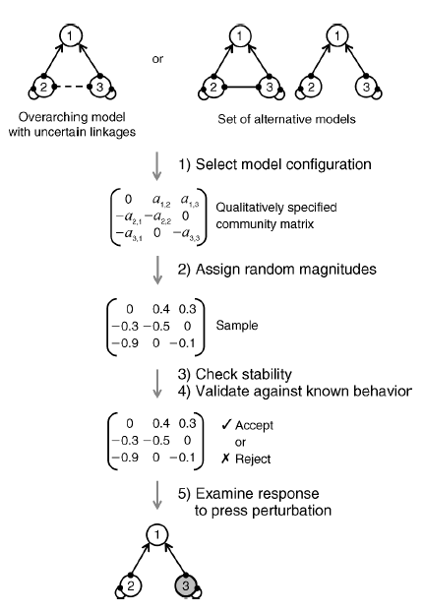
Simulation approach to qualitative modeling
Melbourne-Thomas et al. (2012)

Slide 14
The community matrix is potentially a powerful
theoretical tool when specified with quantitativ e
interaction terms, whether actually measured or
giv en as plausible estimates. In particular, the
inv erse of the negativ e community matrix (/
A1 ) predicts the equilibrium response of community
members following a sustained perturbation
(Nakajima, 1992 ), such as a natural
disturbance or experimental manipulation. Quantitativ e
predictions from the inv erse, howev er,
hav e lacked generality and appear to be highly
sensitiv e to the specific v alues of the aij interaction
coefficients.
‘Loop analysis’ interprets
signed digraphs of community matrix models to
make qualitativ e predictions of system stability
and perturbation response based on the balance of
system feedback.

Slide 15
One difficulty with qualitativ e modeling is
the all-or-none aspect of its predictions. Another
difficulty is applying Lev ins’ loop algorithm,
which relies upon a graphical interpretation of
signed digraph models. For large (/ 5 v ariables)
or complex systems (i.e. high connectance), signed
digraph analysis grows not just exponentially, but
factorially.

Slide 16
Complementary feedback cycles
The computations required in the qualitative
assessment of system response to perturbation are
based upon feedback ‘loops’ or cycles.

Slide 17
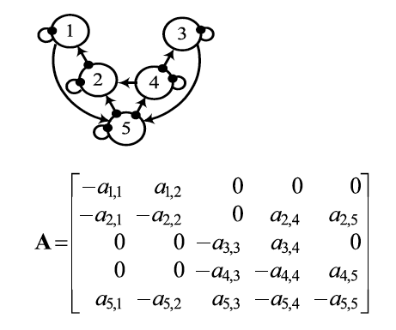
Signed digraphs to community matrix
Dambacher et al. 2003

Slide 18
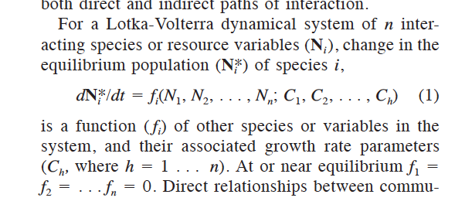
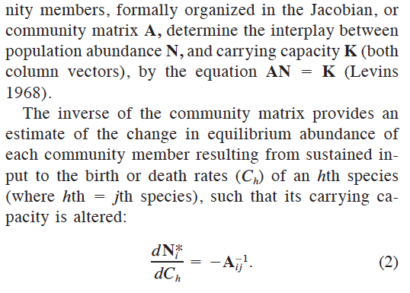
here

Slide 19
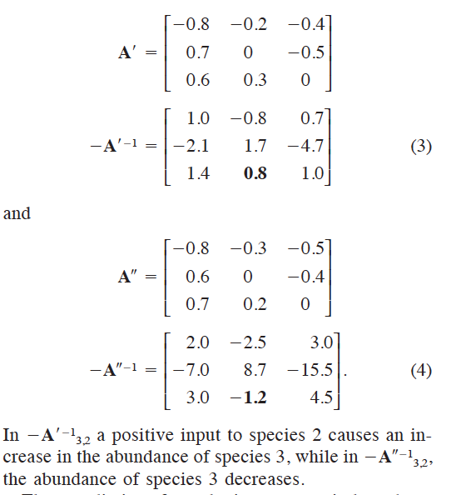
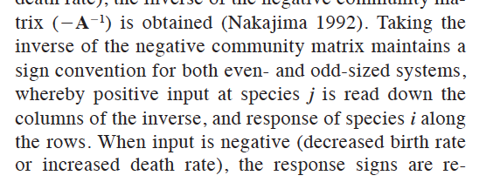
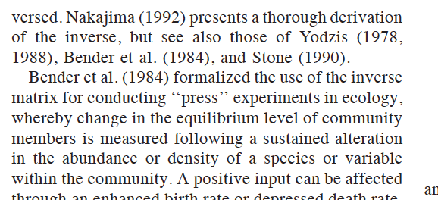
Dambacher et al. 2002

Slide 20
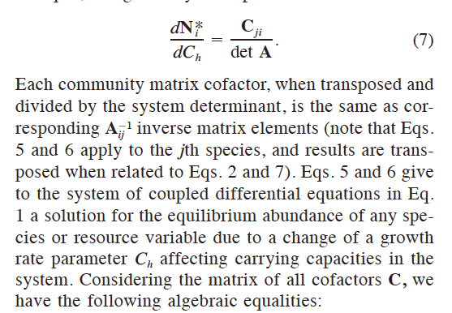
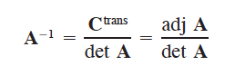
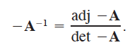
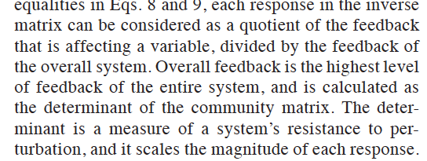
here

Slide 21
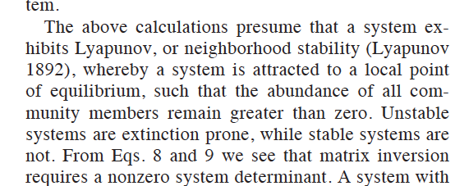
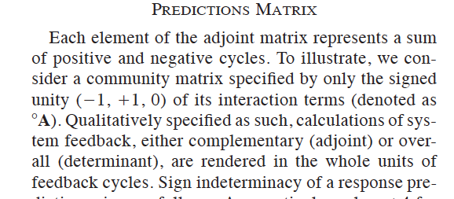
Predictions matrix
nn

Slide 22
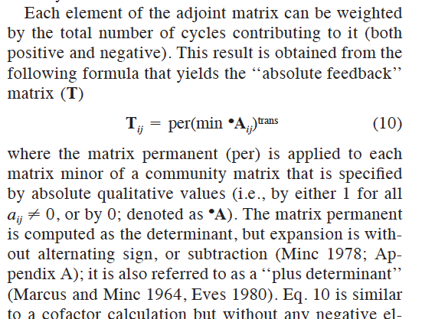
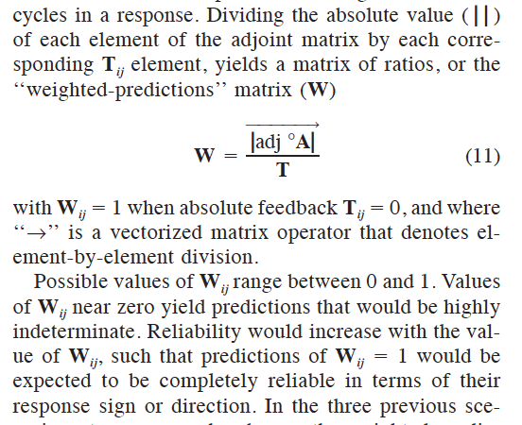
Absolute # of feedbacks and weighted predictions matrix
Each element of T count of total number of positive and negative feedback cycles in a response.
D et al. 2002

Slide 23
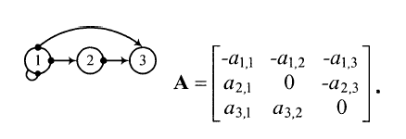
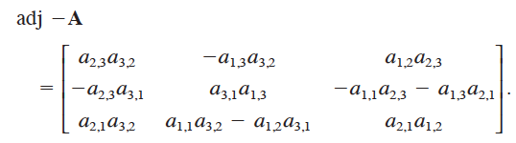
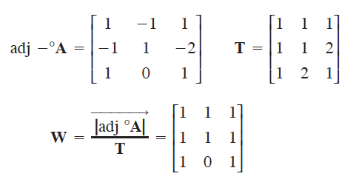
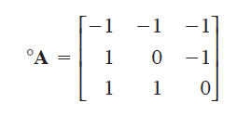

Slide 24
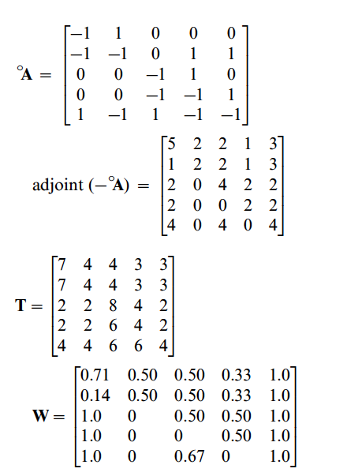
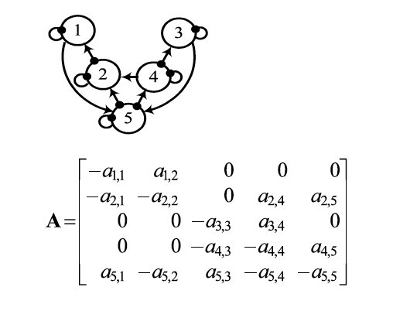
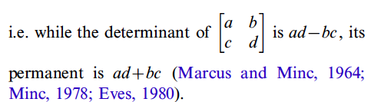

Slide 25
By framing management actions as press perturbations, loop
analysis can be used to strategically examine a foodweb’s response
and provide system-wide understanding, useful for EBM
(Sainsbury et al., 2000; Link, 2010). In marine systems, researchers
have used loop analysis to forecast the response of a coral reef fish
community to sedimentation from dumping of mine waste
(Dambacher et al., 2007), to assess the stability of a nearshore
benthic community after the invasion of abalone (Haliotis discus
hannai; Ortiz and Stotz, 2007), and to compare management
actions for a scallop (Argopecten purpuratus) fishery under different
ocean conditions (Ortiz et al., 2002).

Slide 26
Adding management to loop analysis
Carey et al. (2014)
Added EBM component as an additional variable with interactions on species
Fisheries not part of conceptual model
Tables for Puget Sound

Slide 27
Despite the limitations articulated above, loop analysis can be a
useful tool for informing EBM especially in situations with limited
data. Loop analysis may best be viewed as a screening tool that provides
the raw material to test hypotheses with more detailed
models, field or laboratory experiments, and long-term monitoring.
Loop analysis forces simplification and this can lead to
model predictability and accessibility, though at the expense of
resolution, a trade-off that can benefit researchers in some
instances (Ortiz et al., 2002; Dambacher et al., 2003). For
example, loop analysis was more successful in predicting patterns
than a more complicated foodweb simulation model [Ecopath
with Ecosim (EwE)] in a study exploring the cascading effect of
a top predator in a benthic community of the southeast Pacific
(Ortiz, 2008). Ecosystem simulation models, such as EwE,
require extensive data on species and interactions. When using
data-intensive methods, comparisons among systems may be
limited because similar levels of data are not collected in all
systems. Thus, a simpler qualitative approach may be warranted
(and fruitful). Predictions from loop analysis can be monitored,
used in an adaptive management framework, and suggest research
gaps, all of which facilitates EBM in coastal ecosystems (Lester
et al., 2010; Link, 2010).

Slide 28
Managing complex coastal systems with counterintuitive dynamics
and varied human interests requires EBM. Loop analysis
helps bridge the gap between the theory and the practice of
EBM by providing an accessible tool without prohibitive data
requirements. By knowing the basic foodweb structure (functional
groups and their qualitative linkages), loop analysis can predict the
outcomes for the entire foodweb from a management action

Slide 29
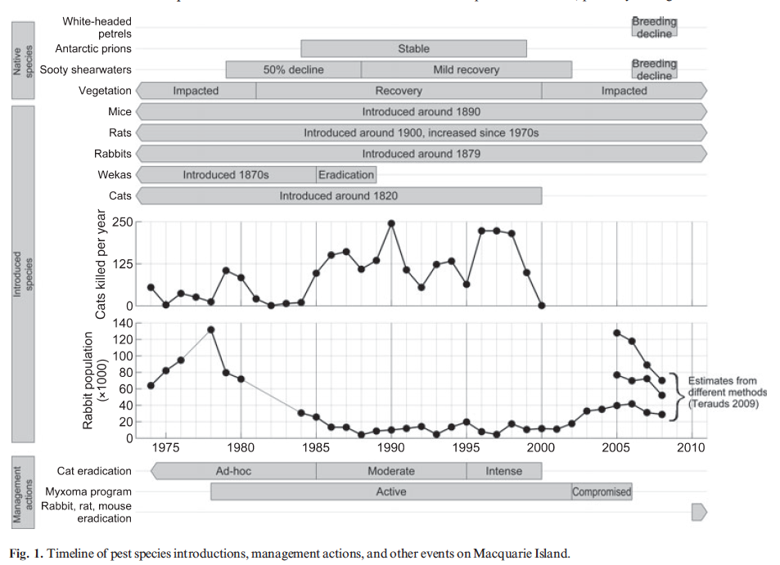
here

Slide 30
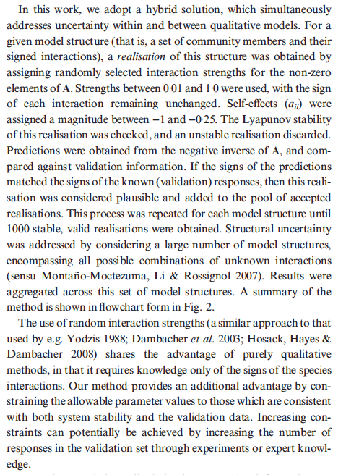
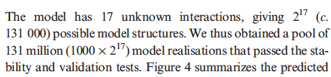
here

Slide 31
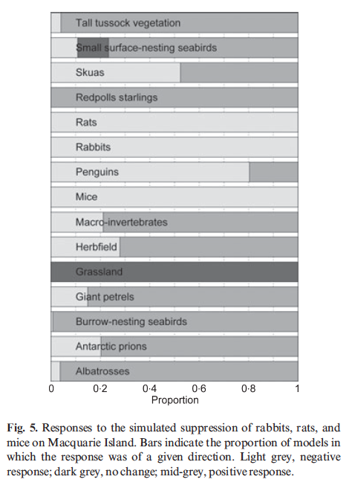
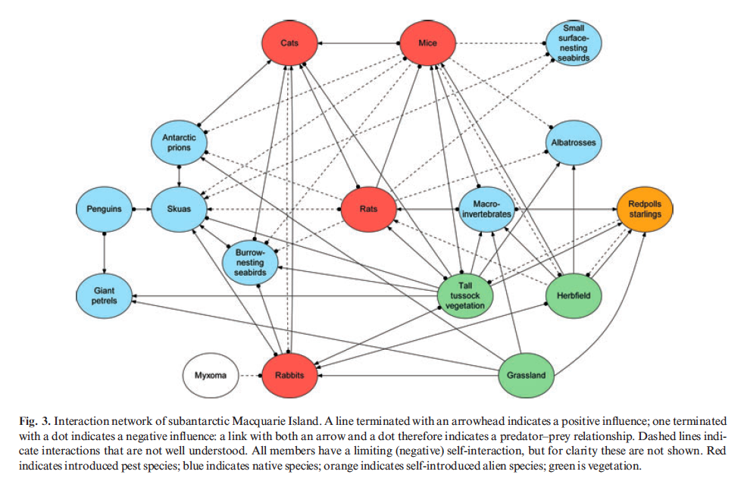
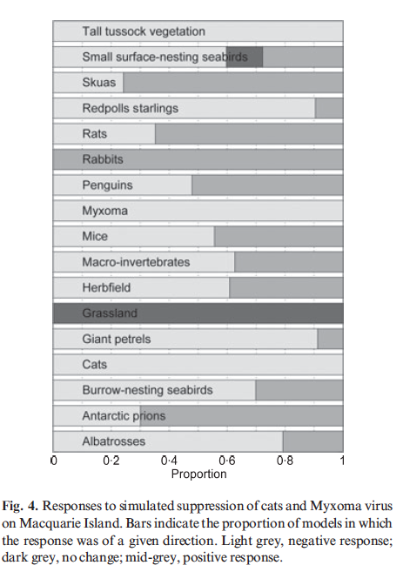
Macquarie island network
Raymond et al. 2011

Slide 32
In linear algebra, a minor of a matrix A is the determinant of some smaller square matrix, cut down from A by removing one or more of its rows or columns. Minors obtained by removing just one row and one column from square matrices (first minors) are required for calculating matrix cofactors, which in turn are useful for computing both the determinant and inverse of square matrices.

Slide 33
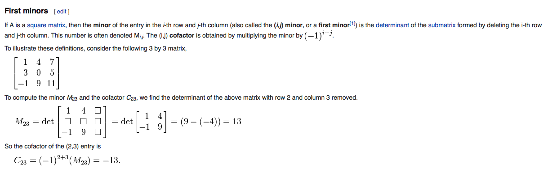
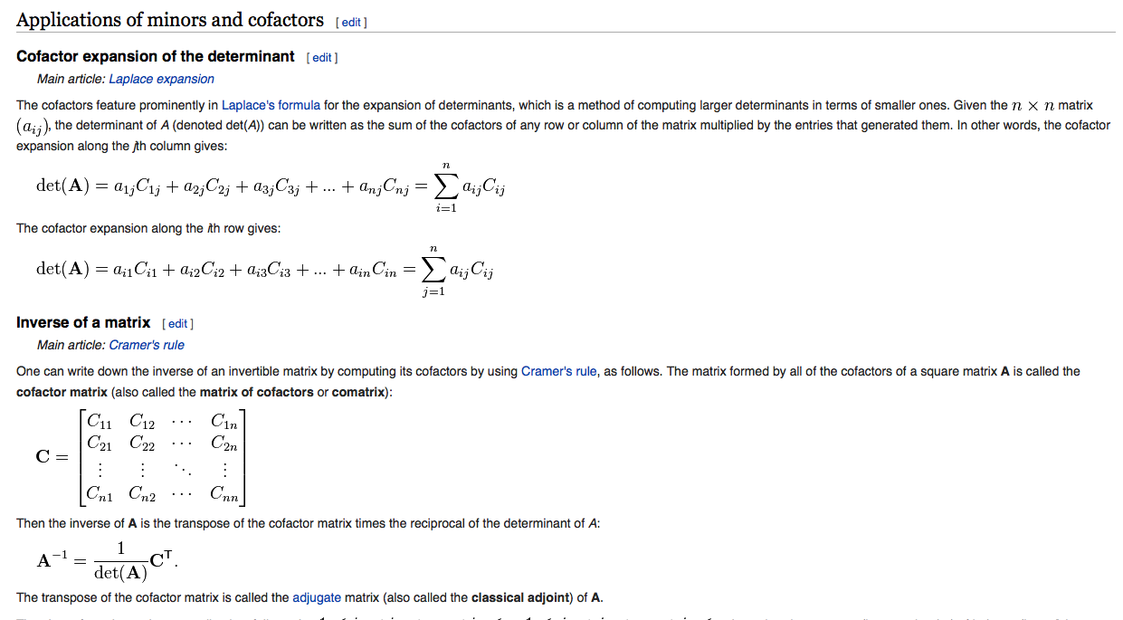
here

Slide 34
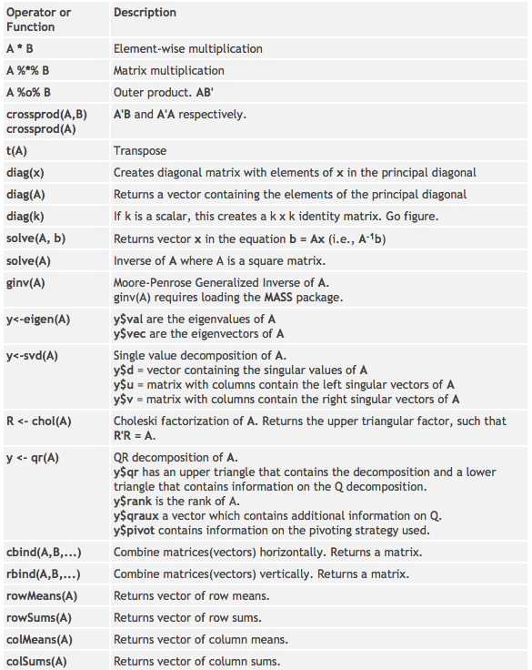
Matrix algebra in R
http://www.statmethods.net/advstats/matrix.html

Slide 35
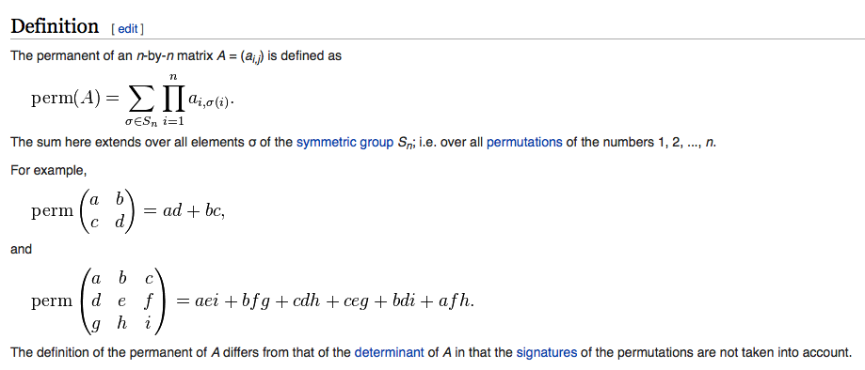
Matrix permanent
here

Slide 36
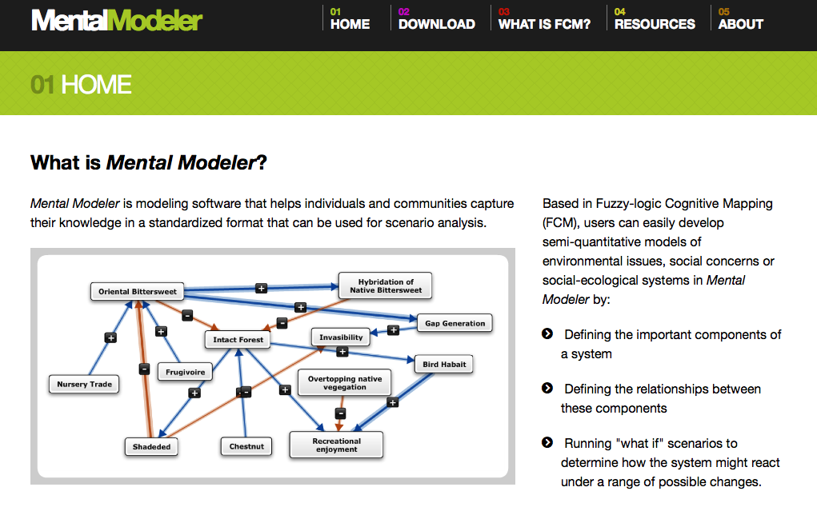
hello

Slide 37
Fuzzy cognitive mapping
A Fuzzy Cognitive Maps (FCMs) is a modelling methodology based on exploiting knowledge and
experience. It comprises the main advantages of fuzzy logic and neural networks, representing
a graphical model that consists of nodes-concepts (describing elements of the system) which
are connected with weighted edges (representing the cause and effect relationships among the
concepts). FCMs have proved to be a promising modeling methodology with many successful
applications in different areas especially for simulating system design, modeling and control.

Slide 38
Georges Bank
Wildermuth slides

Slide 39
Bayesian evaluation of model structure

Slide 40
What is Natural Capital?

Slide 41
How does an ecosystem services approach differ from biodiversity conservation?

Slide 42
Categories of ecosystem services
Supporting services
Nutrient cycling
Photosynthesis
Final
Provisioning
Regulatory
Cultural

Slide 43
Key features of NatCap approach
Participatory
Specific decisions
Metrics that resonate
Highlights people
Context
Iterative

Slide 44
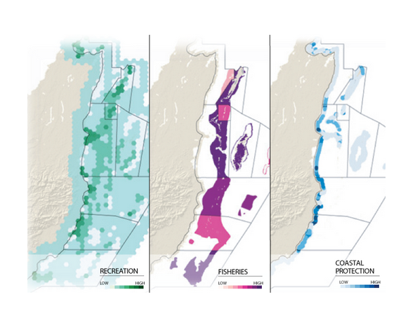

InVEST
Set of tools to model ecosystem services
Impact of alternative scenarios on these services.
InVEST tools focus on three categories:
Supply
Service
Value
Associated Policy tools

Slide 45
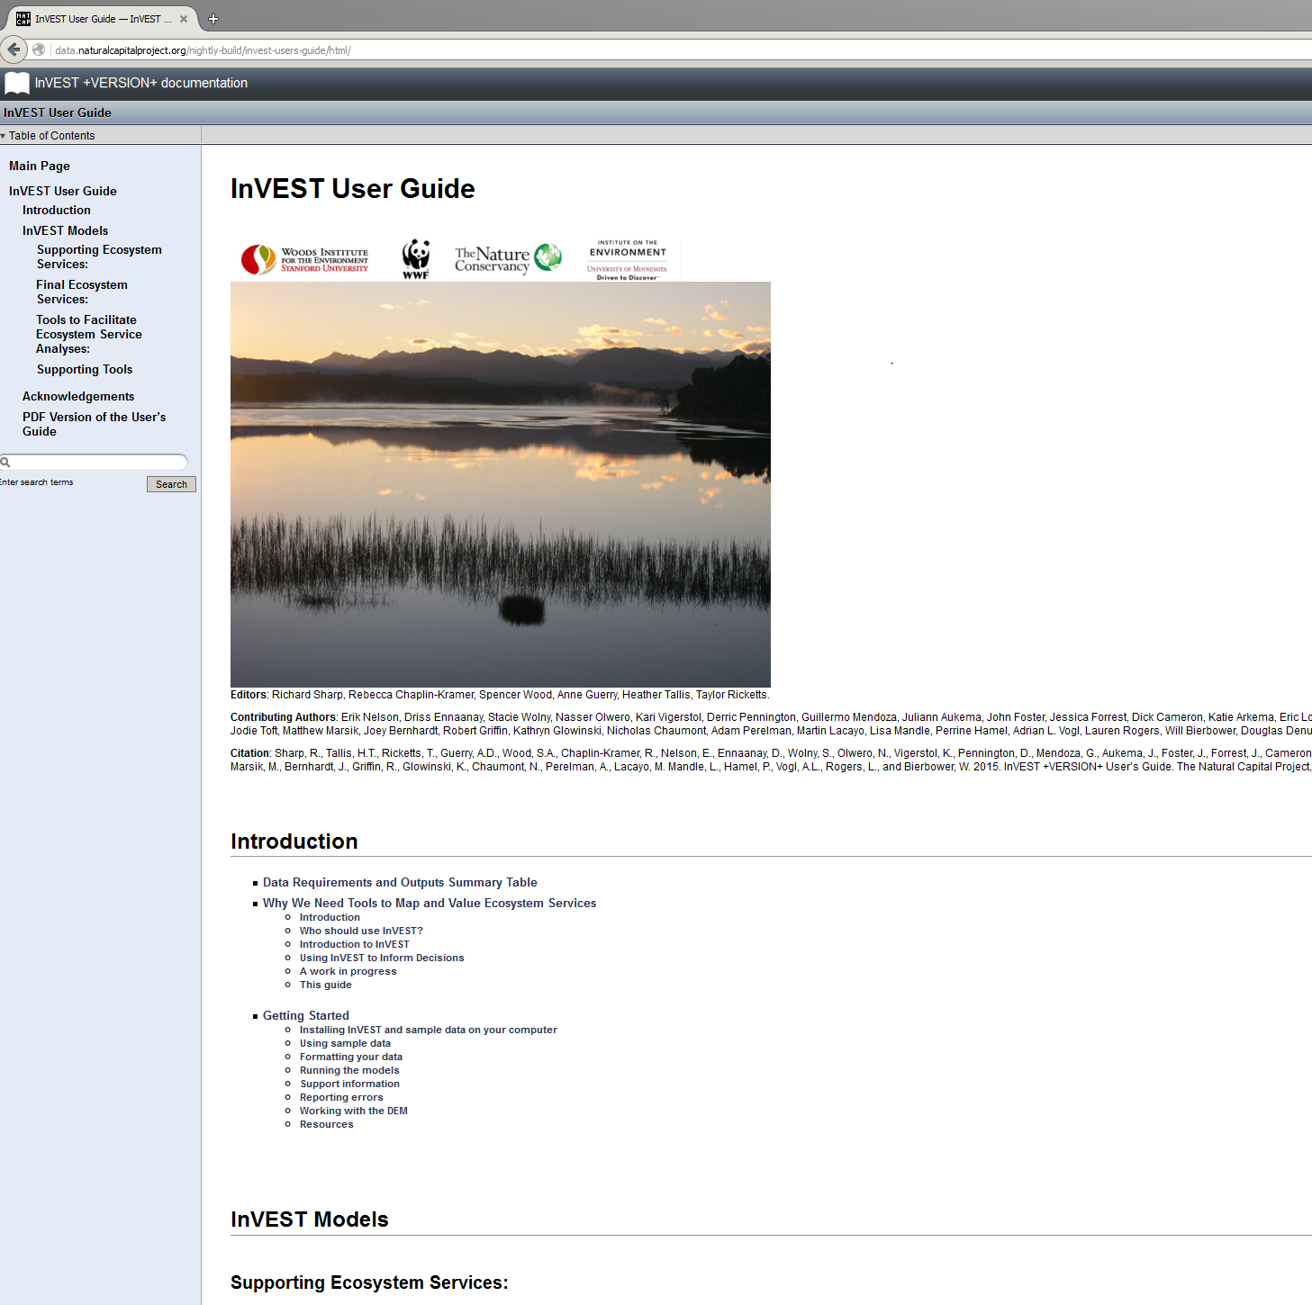
InVEST user guide

Slide 46
Next time on Models for Marine EBM….
(April 15)
Whole of system models, MSE for ecosystems
Atlantis

